Slide 1



COPYRIGHT © 2018 By Khanh.tx@live.com at Testmaster.vn

Slide 2
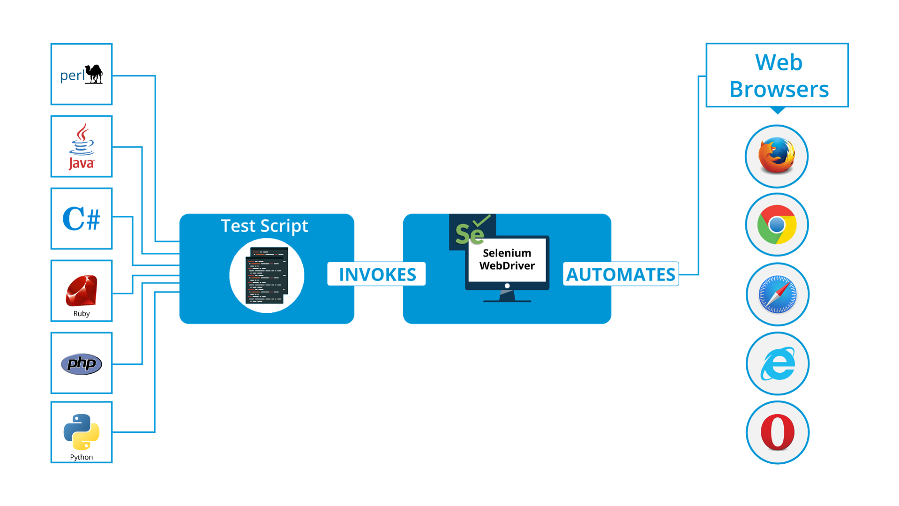
ARCHITECTURE OF WEBDRIVER

Slide 3
WEBDRIVER INTERFACE
WebDriver is an Interface is used for testing, which represents an idealized web browser. The methods in this interface fall into three categories
Control of the browser itself
Selection of Elements
Debugging aids
Key methods are get(String) which is used to load a new web page, and the various methods similar to findElement(By), which is used to find WebElemetns.
Nested Classes
WebDriver.ImeHandler: An interface for managing input methods
WebDriver.Navigation
WebDriver.Options: An interface for managing stuff you would do in browser menu
WebDriver.TargetLocator: Used to locate a given frame or window
WebDriver.Timeouts: An interface for managing timeout behavior for WebDriver instance
WebDriver.Window

Slide 4
WEBDRIVER INTERFACE
Methods
Void get(java.lang.String url) – Load a new web page in the current browser window.
Void close() – Close the current window, quitting the browser if it’s the last window currently open.
String getCurrentUrl() – Get a string representing the current URL that the browser is looking at.
String getTitle() – The title of the current page.
String getPageSource() – Get the source of the last loaded page.
String getWindowHandle() – Return an page handle to this window that uniquely indentifies it with in driver instance.
Set<String> getWindowHandler() – Return a set of window handles which can be used to interate over all open windows of this WebDriver instance by passing them to switchTo().WebDriver.Options.window()

Slide 5
WEBDRIVER INTERFACE
Object Methods
WebElement findElement(By by) – Find the first WebElement using the given method.
List<WebElement> findElements(By by) – Find all elements within the current page using the given mechanism.
WebDriver.Options manage() – Get the option interface
WebDriver.Navigation navigate() – An abstraction allowing the driver to access the browser’s history and to navigate to a given URL.
WebDriver.TargetLocator switchTo() – Send future commands to a different frame or window.

Slide 6
WEBELEMENT INTERFACE
Presents an HTML element. Generally, all interesting operations to do with interacting with page will be performed throught this interface.
Void click(): Click this element.
Void clear(): If this element is a text entry element, this will clear the value.
WebElement findElement(By by): Find the first WebElement using the given method.
List<WebElement> findElements(By by): Find all elements within the current context using the given mechanism.
String getAttribute(String name): Get the value of the given attribute of the element.
String getCssValue(String propertyName): Get the value of a given CSS property.
Point getLocation(): Where on the page is the top left-hand corner of the rendered element?
Dimension getSize(): What is the width and height of the rendered element?
String getTagName(): Get the tag name of this element.
String getText(): Get the text value of this element.
Boolean isDisplayed(): Is this element displayed or not? This method avoids the problem of having to parse an element’s “style” attribute.

Slide 7
WEBELEMENT INTERFACE
Boolean isEnabled(): Is the element currently enabled or not? This will generally return true for everything but disabled input elements.
isSelected(): Determine whether or not this element is selected or not.
Void sendKeys(CharSequense keysToSend): Use this method to simulate typing into an element, which may set its value.
Void submit(): If this current element is a form, or an element within a form, then this will be submitted to the remote server.

